Slide 1
PROJECT TITLE: EVENT DECORATION BOOKING WEBSITE PREPARED BY: NAME: THEOPHILUS MUMO REG. NO: EB3/56380/21

Slide 2
PROBLEM STATEMENT
PROBLEMS
The event planning industry is shifting towards online solutions due to consumer demand for convenience and efficiency.
Existing platforms for event decoration services are inadequate, featuring poor user experiences, inefficient booking management, and limited payment options.
These inadequacies lead to user frustration and missed opportunities for service providers.
Customers struggle to find and book decoration services that meet their specific needs, hindering growth in the market.
SOLUTIONS
The proposed event decoration booking website aims to create an accessible, intuitive platform that streamlines the event planning process.
It seeks to enhance user engagement and satisfaction while providing service providers with a robust solution to showcase their offerings.
By addressing these challenges, the website will meet the growing demand for online services and position itself as a leader in facilitating seamless bookings and payments for decoration services.

Slide 3
OBJECTIVES
General Objectives
To provide an online platform that allows individuals and organizations to browse, select, and book tailored event decoration services, ensuring a seamless and enjoyable experience from initial inquiry to event execution.
Specific Objectives
To Create a Fully Functional Website
To Implement User Registration, Login, and Booking Functionality
To Develop a Comprehensive Catalog of Decoration Options
To Implement a Robust Search Function

Slide 4
JUSTIFICATION
The website's justification can be summarized as follows:
Meet the growing demand for convenient online services
Improve customer engagement and satisfaction
Increase revenue potential
The website's justification is based on the following assumptions:
The demand for online services in the event planning industry will continue to grow
Customers will prefer to use online platforms for their event planning needs
The website's user-centric design and seamless booking experience will differentiate it from existing platforms

Slide 5
REQUIREMENTS
Functional Requirements
Event Management
Admin can create, update, delete, and view events.
Users can browse and search for events.
Booking Management
Users can book tickets for events.
Users can view their booking history.
Admin can manage bookings
User Profile Management
Users can update their profile information.
Users can change their passwords.
Non-Functional Requirements
Performance
Page load times is under 2 seconds.
Security
Implement HTTPS.
Use prepared statements to prevent SQL injection.
Passwords should be hashed.
Usability
The website is responsive and user-friendly.
Maintainability
Code is well developed or easy maintenance and updates .

Slide 6
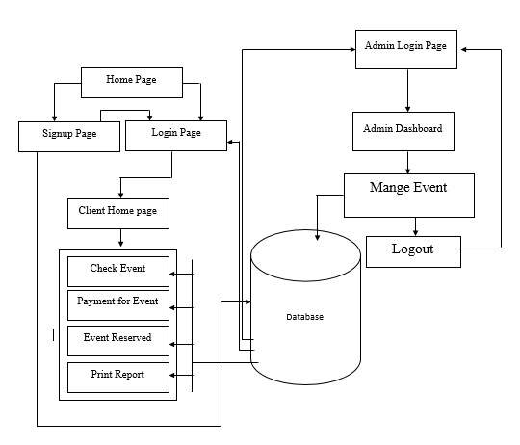
System Design

Slide 7
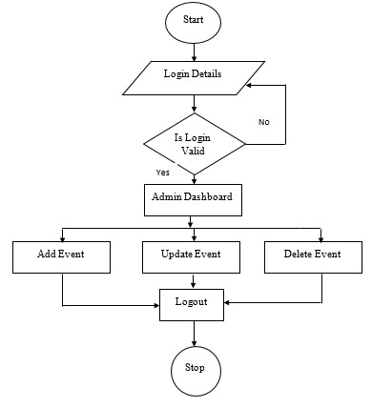
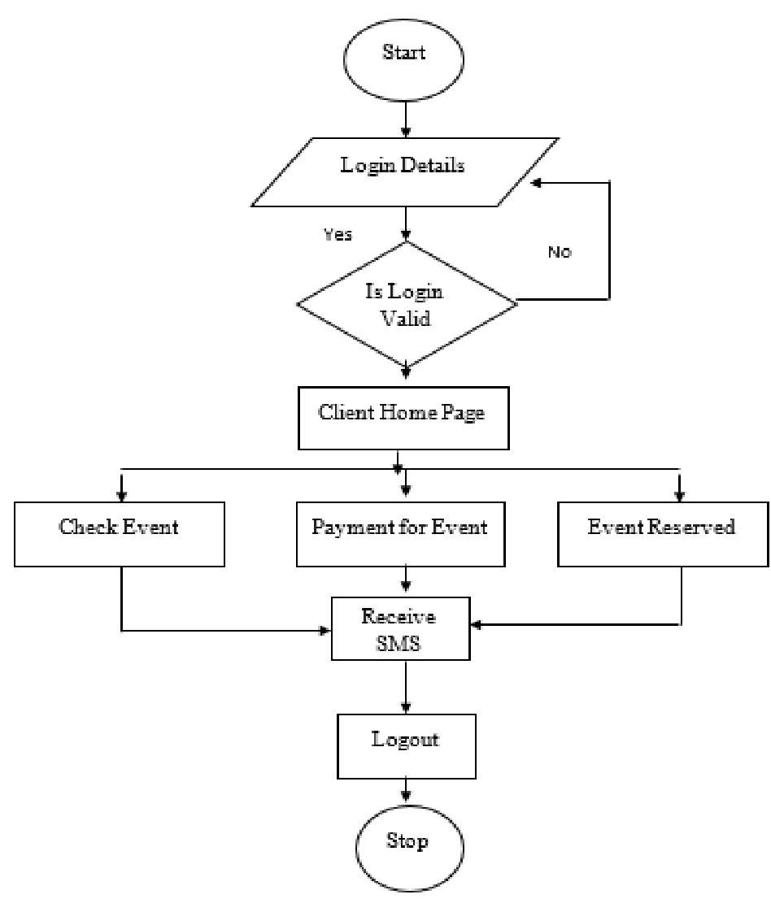
System Design

Slide 8
TOOLS AND TECHNOLOGIES USED
Frontend Development:
HTML: For structuring the web pages.
CSS: For styling and layout design, ensuring a visually appealing interface.
JavaScript: For adding interactivity and dynamic content to the website.
Backend Development:
PHP: For server-side scripting and handling business logic.
XAMPP: As a local development environment that includes Apache server, MySQL, and PHP.
Database Management:
MySQL: For managing user data, booking details, and payment transactions.
Payment Processing:
Payment Gateway Integration: Services like PayPal for secure online transactions.
Development Environment:
IDE/Text Editor: Tools like Visual Studio Code, Sublime Text, or PHP Storm for writing and editing code.

